Slide 1
Open Library Demo
Data Engineering Use Case Study

Slide 2
Data Engineer Use Case Study
Open Library is an initiative of the Internet Archive, a 501(c)(3) non-profit, building a digital library of Internet sites and other cultural artifacts in digital form
Tasks :
  Get the book with the most pages.
  Find the top 5 genres with most books.
  Retrieve the top 5 authors who (co-)authored the most books.
  Per publish year, get the number of authors that published at least one book.
  Find the number of authors and number of books published per month for years between 1950 and 1970.

Slide 3
Use Case Development Approach
Created different layers of data lake in Amazon S3 service.
Deployed Databricks Clusters on AWS EC2 instances with cross Account IAM role.
Mount AWS S3 bucket to Databricks file system(dbfs).
Ingest raw data dump to S3 data Lake Raw layer using databricks Notebook.
Apply data Profiling and Cleansed raw data to put it into Cleansed layer in delta format for handling merge data into target table.
Read delta formatted tables and queried related task data.

Slide 4

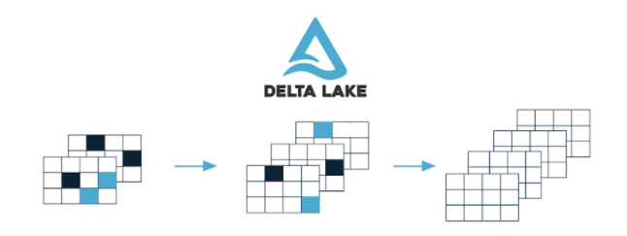
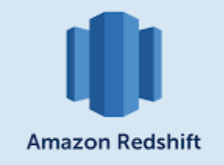




Architecture – Brand Analytics
Batch Source
1
Raw
Cleansed
Publish

Slide 5
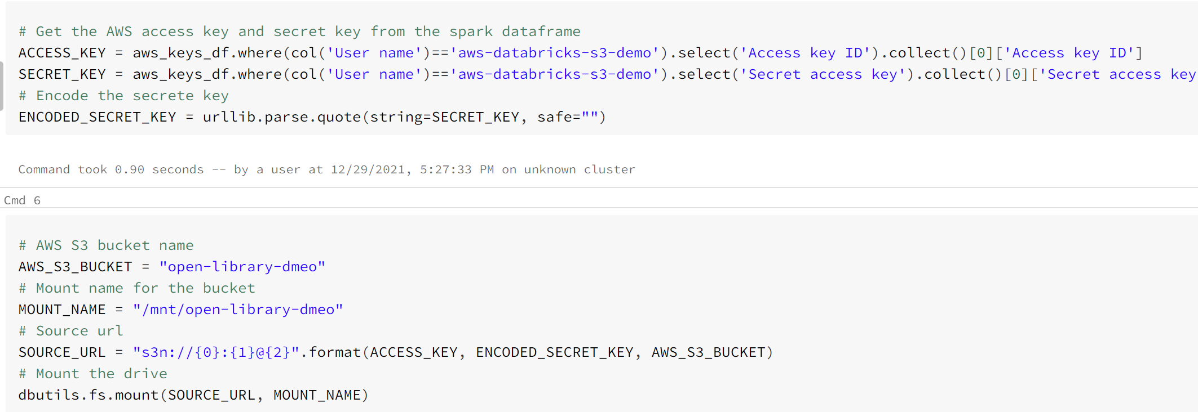
S3 Mount to DBFS

Slide 6
Ingest raw data and apply data Profiling

Slide 7
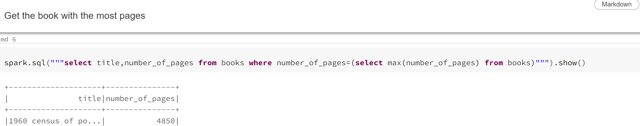
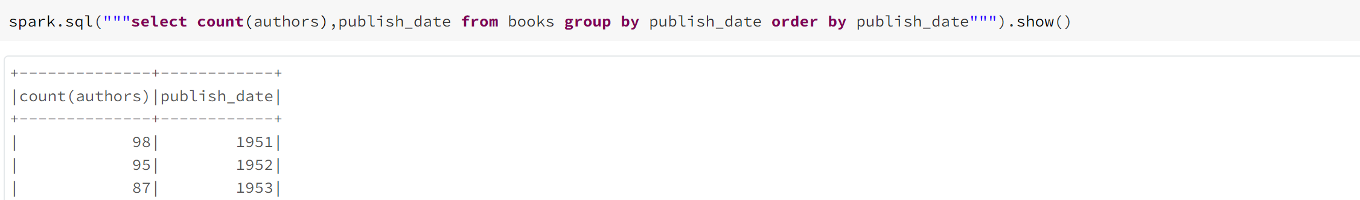
Use Case tasks

Slide 8
Handling Data Merge – Delta lake
Delta lake Supports ACID Properties through delta format.
Upsert can be done into tables with merge command
Merge Automatically validates Schema with the target Table
Automatic schema Evolution to add new source columns into target table.
SCD Type 2 operations can be performed easily with delta tables

Slide 9
ETL Design
Extract
Clean
Transform
Load
Analyze

Slide 10
Scheduling Data Pipeline – Apache Aifrlow
Amazon Managed Workflows for Apache Airflow
Designed to schedule and Orchestrate Etl Data Pipelines
Easy to USE UI for task Monitoring and configurations
Easily setup Alerting Mechanism through Python Callables.

Slide 11
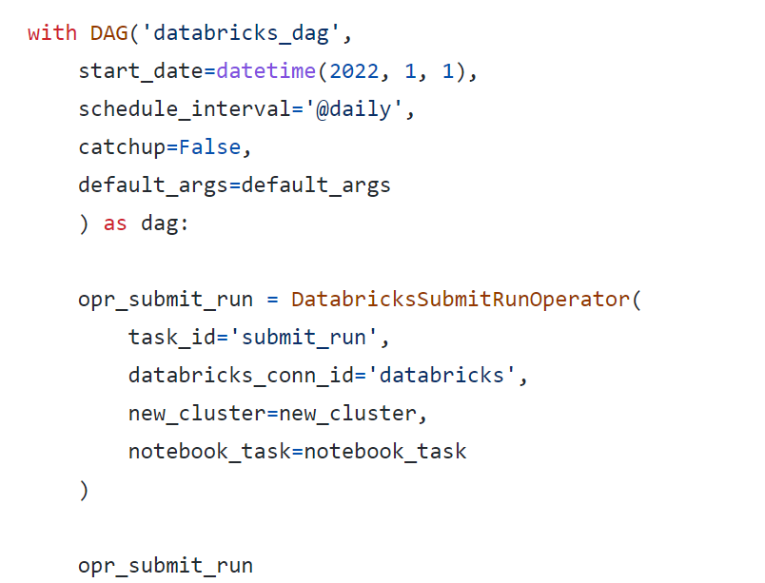
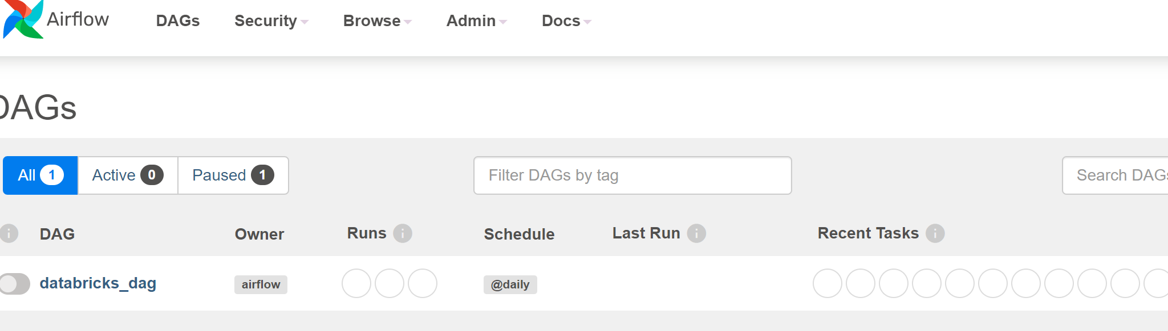
Apache Airflow DAG – Schedule ETL Notebooks

Slide 12
Testing – Unit/Integration
CI/CD can be performed on Databricks Notebooks through Jenkins
Databricks Supports Integration with GitHub to commit code
Unit test Databricks Notebooks with Notebook Parametrization.
Use Databricks connect to develop unit test locally with pytest and run on Databricks clusters.
End to End Integration testing to be performed through orchestrating dev data pipelines through Airflow.

